Slide 1
Aftificial Life: Celular Automata
Dr. Shazzad Hosain
Department of EECS
North South Universtiy
shazzad@northsouth.edu

Slide 2
Defining Artificial Life
Definition
  the analysis and study of life and life-like processes in man-made systems through the use of simulation and synthesis
Why?
  Broaden understanding of what life is by building it artificially
  Explore synthetic evolution
  Life-as-it-could-be vs Life-as-we-know-it

Slide 3
Defining Life
The problem of defining what life “is”
    Life is built by simple, non-living components
    Yet it appears to be more than the mere sum of their interaction
Traditional definitions
  Aristotle, the Greek philosopher, said
    A thing was alive if it could “nourish itself and decay”
  Certain properties are considered to be indicative of life
    Self-reproduction
    Ability to evolve by Darwinian natural selection
    Response to stimuli
    Ability to die
    Growth or expansion

Slide 4
Emergent Behavior
The idea of emergent behavior is fundamental to the field of Artificial life (Alife)
Boids system
  Model the flocking behavior of birds, using two simple rules
  One rule: each boid would stay near to other boids by having each boid tend to move toward the center of gravity of the whole flock
  Another rule: boids did not collide each other
  Boids move extremely similar way in which flock of birds or shoals of fish move
  Simulated in pillar-shaped obstacles. Boids split into two separate flocks to go around the pillar, then rejoined
Notes:
n. Eye dialect spelling of bird, representing mid-20th-century New York City English. n.
A computer simulation of an animal that flies in flocks or swarms.

Slide 5
Finite State Automata (FSA)
FSA is a simple device that has a finite set of states and an input string.
Each input symbol is compared with a rule that dictates to move to the next state
After reading the entire input FSA is either
  in an accepting state, which means the answer is yes or
  in some other state, which means answer is no

Slide 6
What is the language accepted by this machine?
a,b
L = {a,b}* = all finite strings of a’s and b’s

Slide 7
What is the language accepted by this machine?
a,b
a,b

Slide 8
What is the language accepted by this machine?
a,b
a,b
L = all even length strings of a’s and b’s

Slide 9
What machine accepts this language?
L = all strings in {a,b}* that
contain at least one a
b
a,b
a

Slide 10
What machine accepts this language?
L = strings with an odd number of b’s and any number of a’s
a
b
a
b

Slide 11
What is the language accepted by this machine?
a
b
b
a
L = any string ending with a b

Slide 12
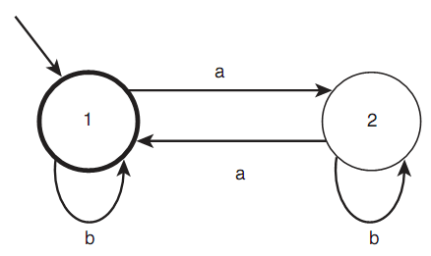
Finite State Automata (FSA)
Accepts even number of a
Only two state, but could have large number of states
Living entities might be considered as an FSA
Boids can be though of as FSAs. Each boid has
  A set of inputs (its location, speeds, other boid location etc.)
  A state, which direction it is flying and how fast
  A set of rules, which state to move from each state, according to input data

Slide 13
Celular Automata: Conway's Life

Slide 14
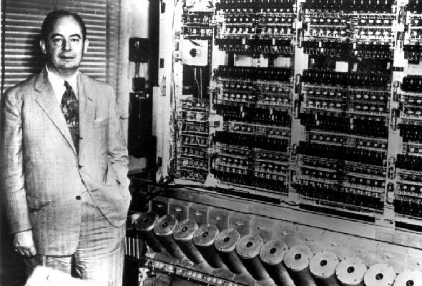
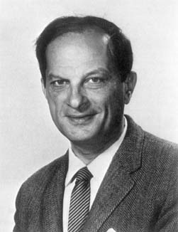
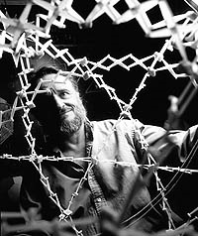
Invention of Cellular Automata
Invented by John von Neumann and Stanislaw Ulam at Los Alamos National Lab (early 1950s)
Based on work by Alan Turing
Most basic research on CA in the 1950s and 60s
Three major events in CA research
  John von Neumann’s self-reproducing automaton
  John Conway’s Game of Life
  Stephen Wolfram’s classification of cellular automata

Slide 15
What is Cellular Automata?
It is a model that can be used to show how the elements of a system interact with each other.
Each element of the system is assigned a cell.
The cells can be:
  2-dimensional squares,
  3-dimensional blocks
  or another shape such as a hexagon.

Slide 16
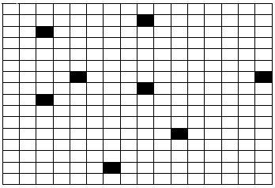
Example of two-dimensional automation
Here is a 2-d model, with 256 cells, each cell in this example can be in either (0 or 1) state,
State 1 is encoded with color black, 0 with white.
Each cell has eight neighbors (excluding itself).

Slide 17
Cellular automation: the specification
A neighborhood function that specifies which of the cell’s adjacent cells affect its state.
A transition function that specifies mapping from state of neighbor cells to state of given cell

Slide 18
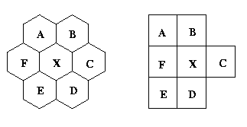

Each cell has a defined neighborhood.
For example, in a one dimension cellular automaton, a neighborhood of radius one for a given cell would include the cell to the immediate right and the cell to the immediate left.
The cell itself may or may not be included in the neighborhood.
Examples of neighborhoods
Different models.
(A,B,C,D,E,F,X) are cells

Slide 19
What are the Applications of Cellular Automata?
Game of Life
Self-reproduction
Diffusion equations
Artificial Life
Digital Physics
Gas particles: Billiard-ball model
Ising model: Ferro-magnetic spins
Heat equation simulation
Percolation models
Wire models
Notes:
universal Turing machine (UTM) is a Turing machine that can simulate an arbitrary Turing machine on arbitrary input. The universal machine essentially achieves this by reading both the description of the machine to be simulated as well as the input thereof from its own tape.
In physics and cosmology, digital physics is a collection of theoretical perspectives based on the premise that the universe is, at heart, describable by information, and is therefore computable. Therefore, the universe can be conceived of as either the output of a computer program, a vast, digital computation device, or mathematically isomorphic to such a device.

Slide 20
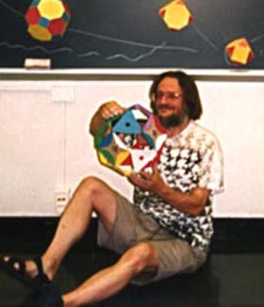
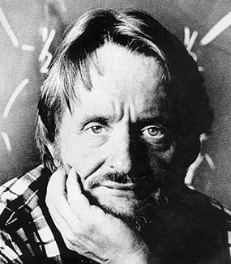
Life - Conway’s Game of Life
John H. Conway

Slide 21
Life - The Game
A cell dies or lives according to some transition rule
The world is round (flips over edges)
How many rules for Life? 20, 40, 100, 1000?
transition
rules
T = 0
T = 1

Slide 22
Life - The Game
Three simple rules
dies if number of alive neighbour cells =< 2 (loneliness)
dies if number of alive neighbour cells >= 5 (overcrowding)
lives is number of alive neighbour cells = 3 (procreation)

Slide 23
SOS - Lecture 4
Life - The Game
Life - The Game
Examples of the rules
loneliness (dies if #alive =< 2)
overcrowding (dies if #alive >= 5)
procreation (lives if #alive = 3)

Slide 24
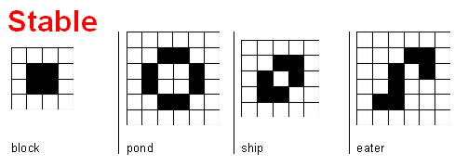
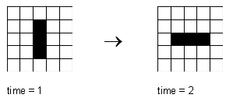
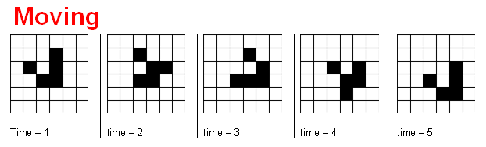
SOS - Lecture 4
Life - Patterns
Periodic
The transition rule for this example, is :
  a cell stays in state 1 (black), if it has two or three black neighbors.
  a cell changes to black, if it has exactly three black neighbors.
Notes:
The transition rule for this example, is :
a cell stays in state 1 (black), if it has two or three black neighbors.
a cell changes to black, if it has exactly three black neighbors.

Slide 25
In the initial configuration of the cellular automata, each cell is assigned a "starting" value from the range of possible values.
For example, if the range of possible values is 0 or 1, then each cell would be assigned a 0 or a 1 in the initial configuration.
Each value represents a color to the computer.
Each cell is associated a transition rule.
Example of description of a cellular automaton

Slide 26
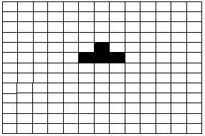
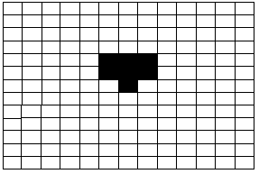
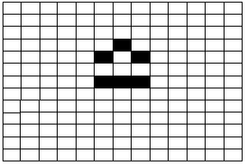
Initial Step1 Step2
Here is an example
In this example, the initial configuration for all the cells is state 0, except for 4 cells in state 1.
The transition rule for this example, is :
  a cell stays in state 1 (black), if it has two or three black neighbors.
  a cell changes to black, if it has exactly three black neighbors.
The next slide shows animation for this example

Slide 27
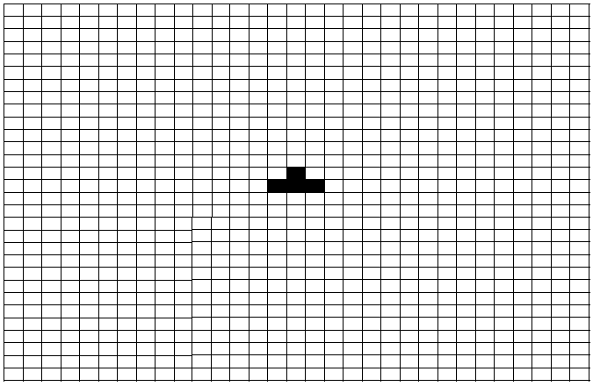

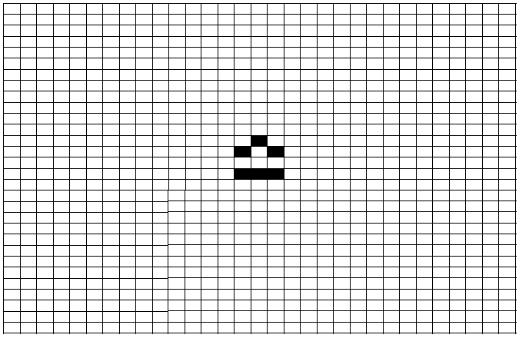



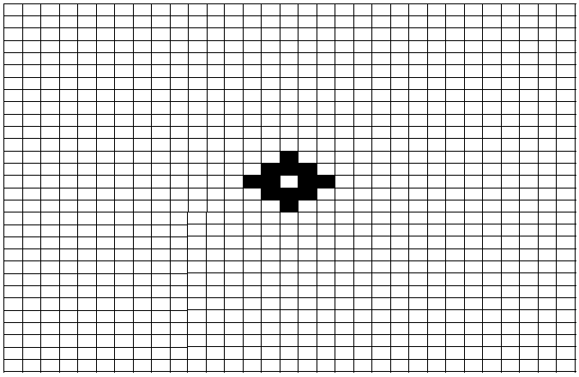


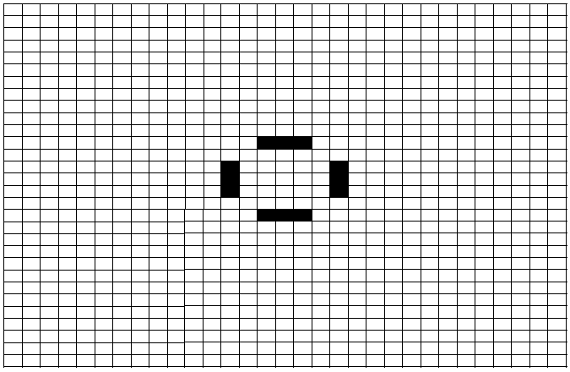
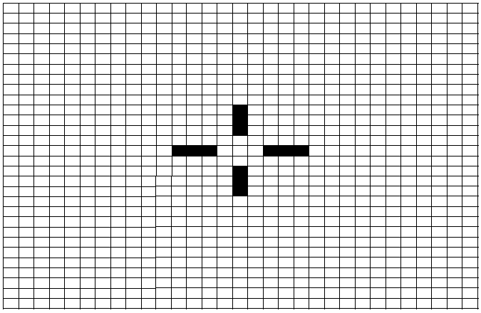

Slide 29
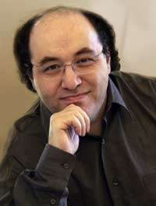
Classifying Cellular Automata Rules
Stephen Wolfram
Class One - Fixed or Static: Rules that produce dull universes, such as all dead cells or all living cells; e.g. ice.
Class Two - Periodic or Oscillatory: Rules that produce stable, repetitive configurations.
Class Three - Chaotic: Rules that produce chaotic patterns; e.g. molecules in a gas.
Class Four - Complexity: Rules that produce complex, locally organized patterns; e.g. behave like a flowing liquid..

Slide 30
Let us now find some real-life examples!!!

Slide 31
Cellular Automata: Life with Simple Rules
Sharks and Fish: Predator/Prey Relationships
Based on the work of Bill Madden, Nancy Ricca and Jonathan Rizzo
(Montclair State University)
Cellular automata can be used to model complex systems using simple rules.
Key features*
  divide problem space into cells
  each cell can be in one of several finite states
  cells are affected by neighbors according to rules
  all cells are affected simultaneously in a generation
  rules are reapplied over many generations
*Adapted from: Wilkinson,B and M. Allen (1999): Parallel Programming 2nd Edition, NJ, Pearson Prentice Hall, p189

Slide 32
Main idea
Model predator/prey relationship by CA
Define set of rules
Begins with a randomly distributed population of fish, sharks, and empty cells in a 1000x2000 cell grid (2 million cells)
Initially,
  50% of the cells are occupied by fish
  25% are occupied by sharks
  25% are empty

Slide 33
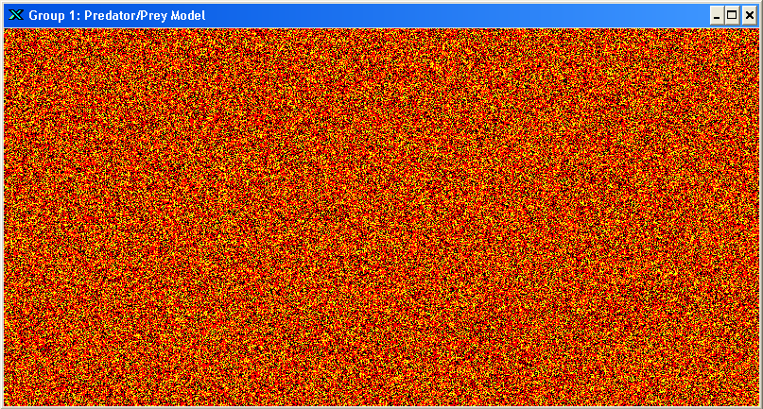
Here’s the number 2 million
Fish: red; sharks: yellow; empty: black

Slide 34
Rules
A dozen or so rules describe life in each cell:
birth, longevity and death of a fish or shark
breeding of fish and sharks
over- and under-population
fish/shark interaction
Important: what happens in each cell is determined only by rules that apply locally, yet which often yield long-term large-scale patterns.

Slide 35
Do a LOT of computation!
Apply a dozen rules to each cell
Do this for 2 million cells in the grid
Do this for 20,000 generations
Well over a trillion calculations per run!
Do this as quickly as you can
Initially cells contain fish, sharks or are empty
Empty cells = 0 (black pixel)
Fish = 1 (red pixel)
Sharks = –1 (yellow pixel)

Slide 36
Rules in detail: Breeding Rule
Breeding rule: if the current cell is empty
If there are >= 4 neighbors of one species, and >= 3 of them are of breeding age,
        Fish breeding age >= 2,
        Shark breeding age >=3,
and there are <4 of the other species:
then create a species of that type
        +1= baby fish (age = 1 at birth)
        -1 = baby shark (age = |-1| at birth)

Slide 37
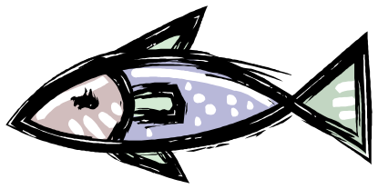
Breeding Rule: Before
 | EMPTY

Slide 38
Breeding Rule: After

Slide 39
Rules in Detail: Fish Rules
If the current cell contains a fish:
Fish live for 10 generations
If >=5 neighbors are sharks, fish dies (shark food)
If all 8 neighbors are fish, fish dies (overpopulation)
If a fish does not die, increment age

Slide 40
Rules in Detail: Shark Rules
If the current cell contains a shark:
Sharks live for 20 generations
If >=6 neighbors are sharks and fish neighbors =0, the shark dies (starvation)
A shark has a 1/32 (.031) chance of dying due to random causes
If a shark does not die, increment age

Slide 41

Shark Random Death: Before
I Sure Hope that the
random number
chosen is >.031

Slide 42
Shark Random Death: After
YES IT IS!!!
I LIVE ☺

Slide 43
Parallelism
A single CPU has to do it all:
  Applies rules to first cell in array
  Repeats rules for each successive cell in array
  After 2 millionth cell is processed, array is updated
  One generation has passed
  Repeat this process for many generations
  Every 100 generations or so, convert array to red, yellow and black pixels and send results to screen

Slide 44
Next several screens show behavior over a span of 10,000+ generations (about 25 minutes on a cluster of 20 processors )

Slide 45
Generation: 0
Fish: red; sharks: yellow; empty: black

Slide 46
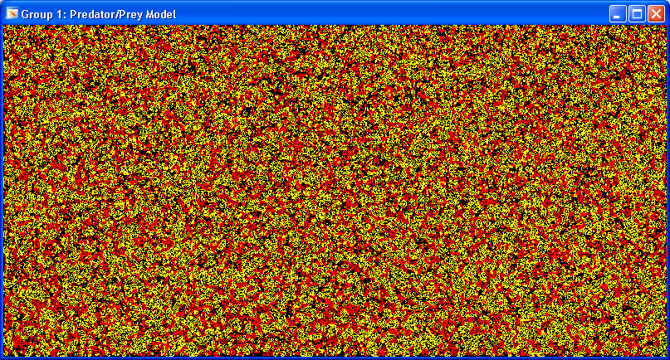
Generation: 100
Fish: red; sharks: yellow; empty: black

Slide 47
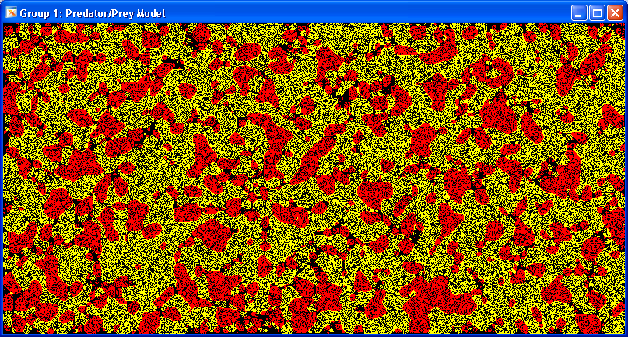
Generation: 500
Fish: red; sharks: yellow; empty: black

Slide 48
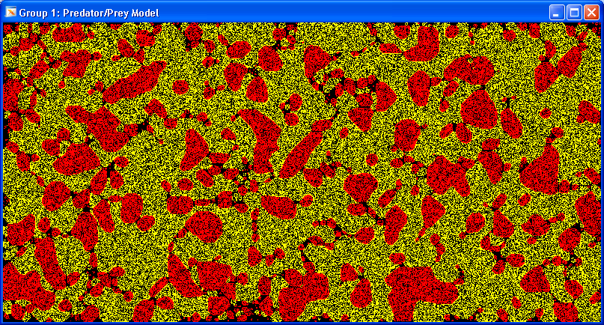
Generation: 1,000
Fish: red; sharks: yellow; empty: black

Slide 49
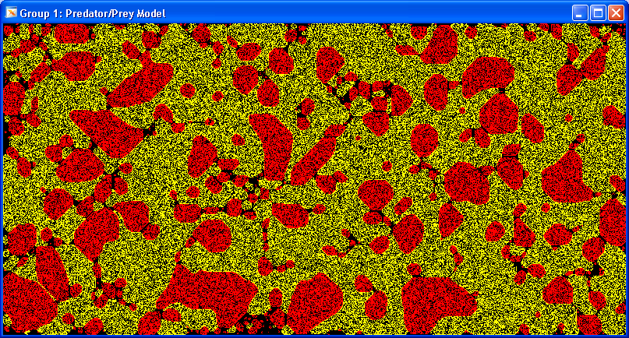
Generation: 2,000
Fish: red; sharks: yellow; empty: black

Slide 50
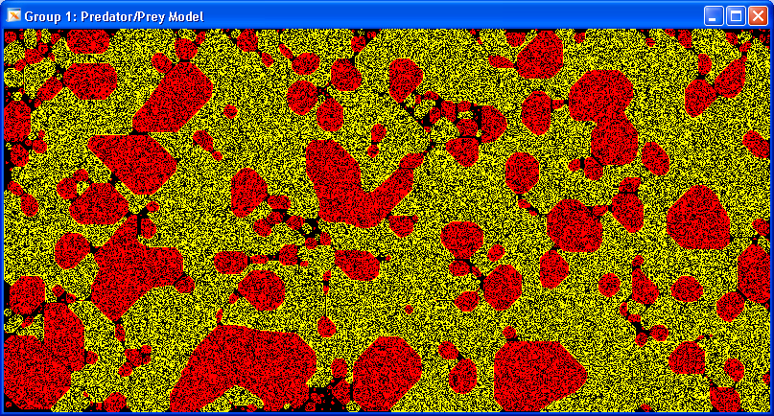
Generation: 4,000
Fish: red; sharks: yellow; empty: black

Slide 51
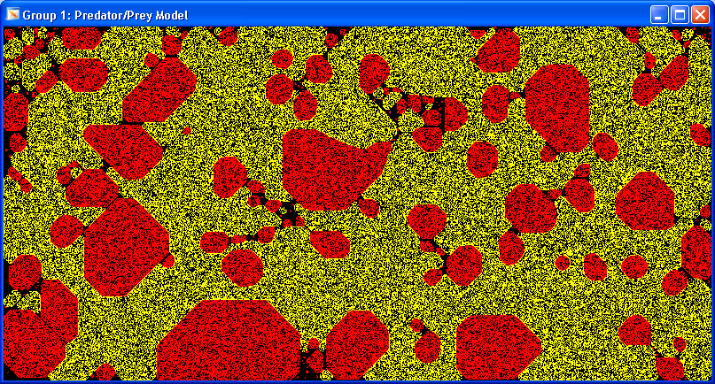
Generation: 8,000
Fish: red; sharks: yellow; empty: black

Slide 52
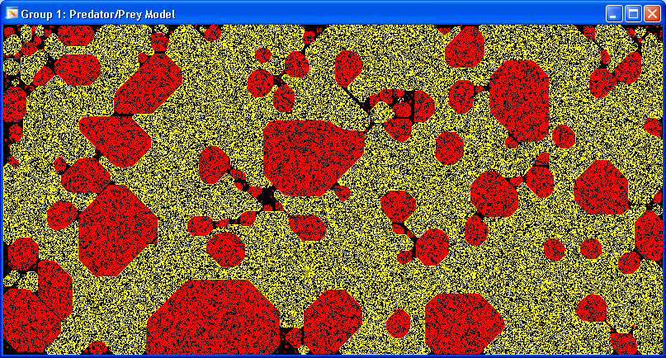
Generation: 10,500
Fish: red; sharks: yellow; empty: black

Slide 53
What is the main characteristics of Cellular Automata?
Synchronous computation
Infinitely-large grid:
  but finite occupancy,
  grows when needed
Various dimensions (1D, 2D, 3D, …)
Typically fine-grain
If cells are distributed, they still need to communicate across boundaries; they communicate once per cycle.

Slide 54
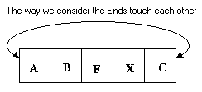
The cells on the end may (or may not) be treated as "touching" each other as if the line of cells were circular.
If we consider them as they touch each other, then the cell (A) is a neighbor of cell (C)
One-Dimensional Cellular Automaton with Wrap-around

Slide 55
Beyond Life - Cellular Automata
“A CA is an array of identically programmed automata, or cells,
which interact with one another in a neighborhood and have
definite state”

Slide 56
Cellular Automata - Array
Cellular Automata - Array
“A CA is an array of identically programmed automata, or cells,
which interact with one another in a neighbourhood and have
definite state”
1
45
34
12
90
4
27
7
1
0
1
1
0
1
0
0
H
Q
M
S
W
E
T
G
1 dimensional
2 dimensional
G
O
M
R
A
W
J
D
X
R
E
P
N
I
Z
T

Slide 57
SOS - Lecture 4
Cellular Automata - Cells
Cellular Automata - Cells
“A CA is an array of identically programmed automata, or cells,
which interact with one another in a neighbourhood and have
definite state”
if #alive =< 2, then die
if #alive = 3, then live
if #alive >= 5, then die
if #alive =< 2, then die
if #alive = 3, then live
if #alive >= 5, then die
if #alive =< 2, then die
if #alive = 3, then live
if #alive >= 5, then die

Slide 58
SOS - Lecture 4
Cellular Automata - Interaction
Cellular Automata - Interaction
“A CA is an array of identically programmed automata, or cells,
which interact with one another in a neighborhood and have
definite state”
Rules
if #alive =< 2, then die
if #alive = 3, then live
if #alive >= 5, then die

Slide 59
SOS - Lecture 4
Cellular Automata - Neighborhood
Cellular Automata - Neighbourhood
“A CA is an array of identically programmed automata, or cells,
which interact with one another in a neighborhood and have
definite state”
Moore
neighborhood
Neumann
neighborhood
Notes:
See the shading. Moore neighborhood 8 cells are neighbor, Neumann case four are neighbors.

Slide 60
SOS - Lecture 4
Cellular Automata - States
Cellular Automata - States
“A CA is an array of identically programmed automata, or cells,
which interact with one another in a neighborhood and have
definite state”
2 possible states: ON OFF
Never infinite!
A
G
O
M
R
Z
A
W
J
D
26 possible states: A … Z
X
R
E
P
N
I
Z
T

Slide 61
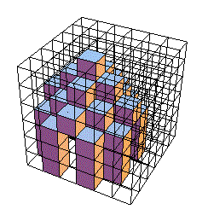
One difficulty with three-dimensional cellular automata is the graphical representation (on two-dimensional paper or screen)
Example of a three-dimensional cellular automaton

Slide 62
References
Chapter 13 of “AI Illuminated” by Ben Coppin.

